Slide 1

Executive Summary

Slide 2
Data Summary
Prepared and made available by Davide Anguita, et al. from the University of Genova, Italy and is described in full in their 2013 paper “A Public Domain Dataset for Human Activity Recognition Using Smartphones.”
30 subjects aged between 19 and 48 years old
Performing one of 6 standard activities while wearing a waist-mounted smartphone (Walking, Walking Upstairs, Walking Downstairs, Sitting, Standing, Laying)
Data was labeled manually from recorded videos
Movement data recorded was the x, y, and z accelerometer data (linear acceleration) and gyroscopic data (angular velocity) from the waist-mounted Samsung Galaxy II - 50 Hz

Slide 3
Data Summary
The dataset is partially preprocessed (noise filters, fixed windows of 2.56 seconds (128 data points) with 50% overlap, splitting of accelerometer data into gravitational (total) and body motion components)
Split into train (70%) and test (30%) 🡪 21 subjects for train and nine for test.
7,352 rows or windows of data, where each window has 128 observations, for 9 features
 | samples | timesteps | features
Training | 7352 | 128 | 9
Test | 2947 | 128 | 9

Slide 4
Data Summary
Is the data biased?
Train Dataset
Class=1, total=1226, percentage=16.676
Class=2, total=1073, percentage=14.595
Class=3, total=986, percentage=13.411
Class=4, total=1286, percentage=17.492
Class=5, total=1374, percentage=18.689
Class=6, total=1407, percentage=19.138
Test Dataset
Class=1, total=496, percentage=16.831
Class=2, total=471, percentage=15.982
Class=3, total=420, percentage=14.252
Class=4, total=491, percentage=16.661
Class=5, total=532, percentage=18.052
Class=6, total=537, percentage=18.222
No

Slide 5
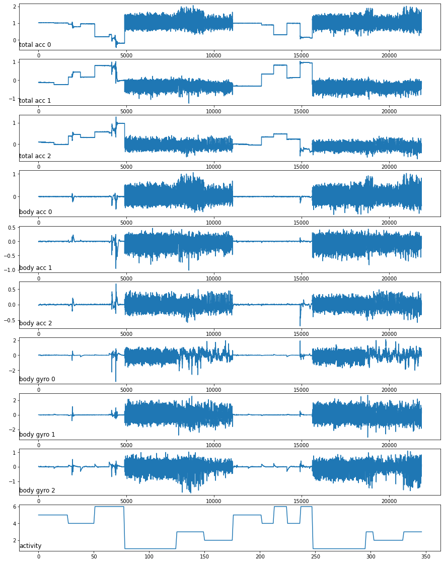
Line plot for all variables for a single subject
Notes:
plot 2: The pattern we see with the total vs. body acceleration distributions by activity mirrors what we see with the same data types across subjects in the previous section. Perhaps the total acceleration data is the key to discriminating the activities.

Slide 6
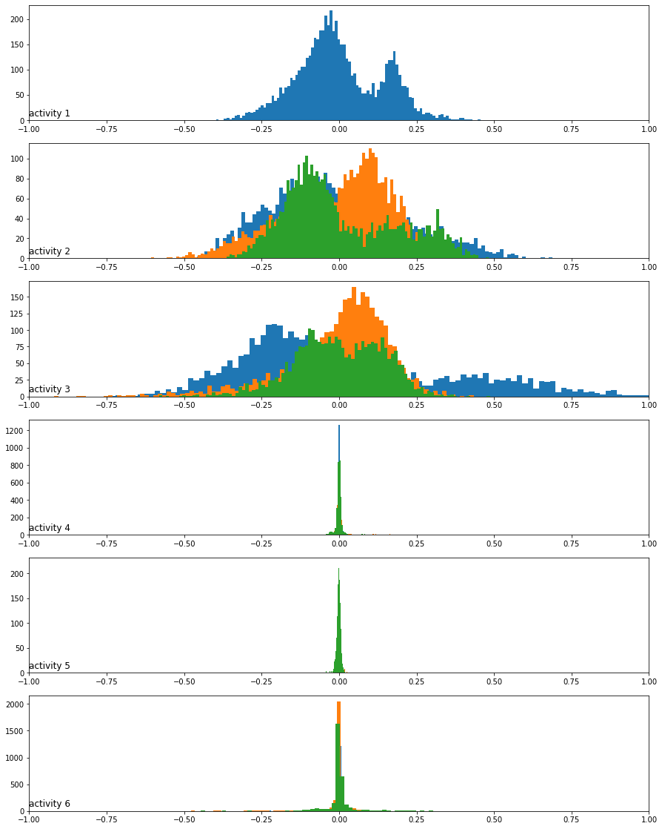
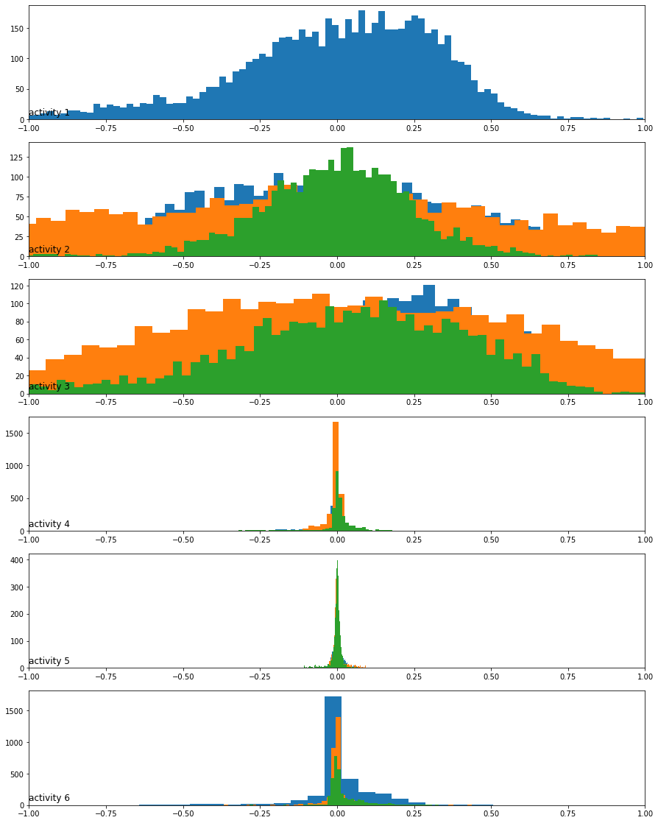
Histograms of the body acceleration data by activity
Histograms of the body gyroscope data by activity
Notes:
plot 2: The pattern we see with the total vs. body acceleration distributions by activity mirrors what we see with the same data types across subjects in the previous section. Perhaps the total acceleration data is the key to discriminating the activities.

Slide 7
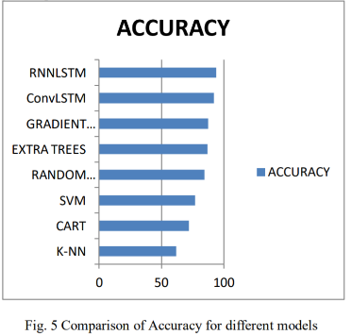
Process going forward
Data Loading and further Processing
Model Building
Assessment and Selection
Citation needed

Slide 8

Tools
GitHub
DeepNote vs Google Colab
Should we stick to Pytorch?

